Slide 1




You Only Recognize Once:
Towards Fast Video Text Spoting
Zhanzhan Cheng¹²; Jing Lu¹; Yi Niu¹ et al.
¹Zhejiang University
²Hikvision Research Institute
³ Fudan University
Program ID: P2C-11
Notes:
Hello，I'm lu jing from hikvision research institution,

Slide 2
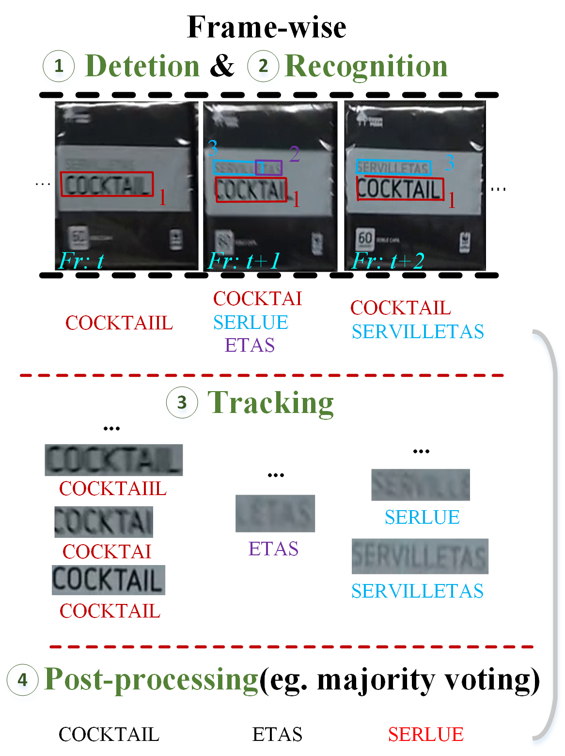
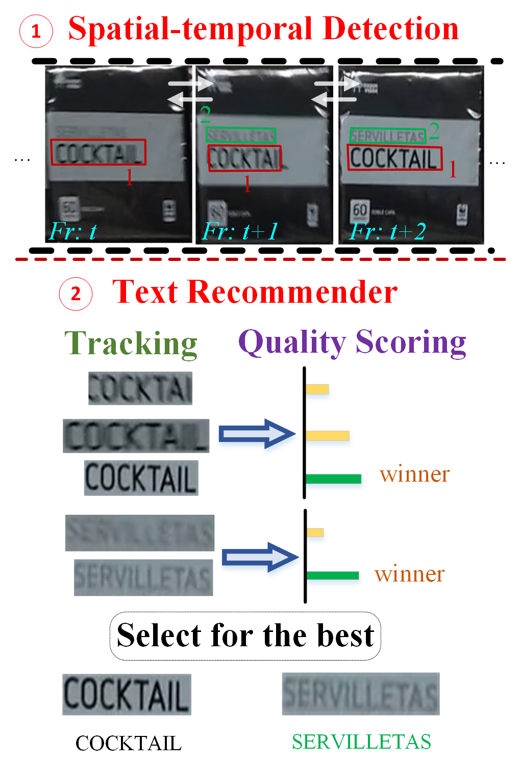
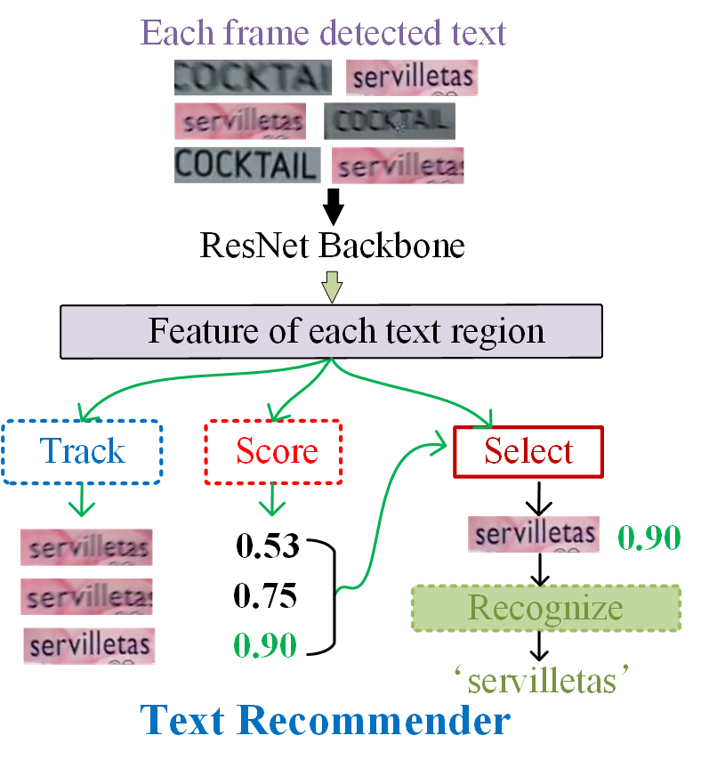
YORO-Fast Video Text Spotting
Motivation
Contribution
Problems of existing framework
Advantages of our framework
An unifed two-stage framework YORO for fast video text spotting :
A self-attention based robust detector
A noval text recommender for fast text recognition
Fast and robust recogntion:
unstable recognition results
more robust results
excessive computational cost
faster by recognizing once
Program ID: P2C-11
Notes:
here we propose a fast video text spotting framework.
Most existing framework follows the pipline of detection, recognition, tracking and post-processing, in which the detection and reocogition process are frame-wise, which leads to excessive cimputational cost, and result in unstable recognition results caused by low-quality text, also the post-processing strategy are usually very sophisticated.
Instead, our framework only contains 2 stages, the self-attention based spatial-temporal detector, and the text recommender for fast text recognition.
As shown in the right figure, the text recommender extracts features from each detected text region, then feeds them into the tracker for text association and the scorer for generating the quality scores, subsequently the feature of the highest quality in a text stream is selected for the final one-time recognition.
The key component in the text recommender is the quality scoring network.

Slide 3
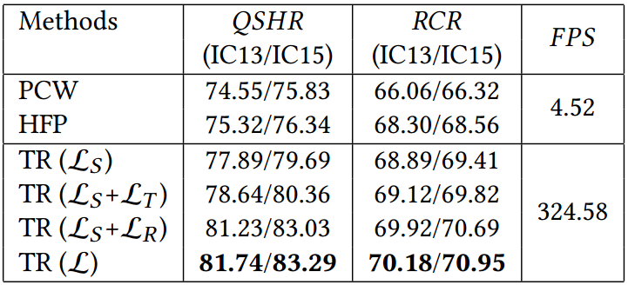
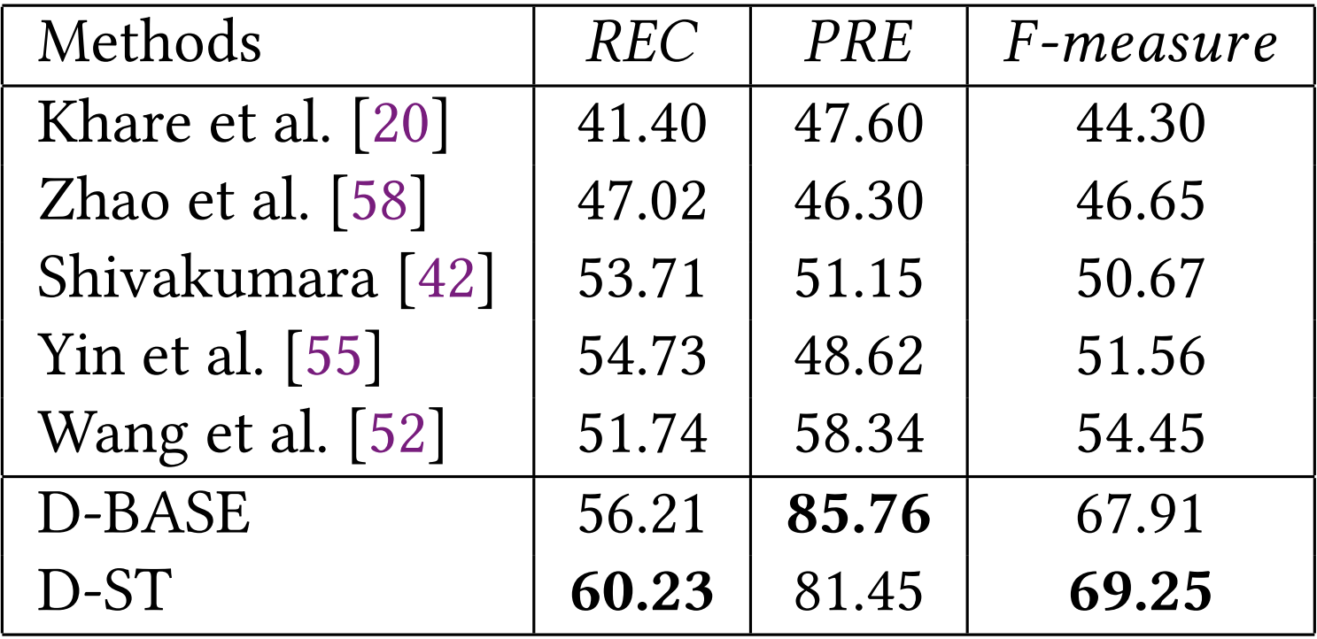
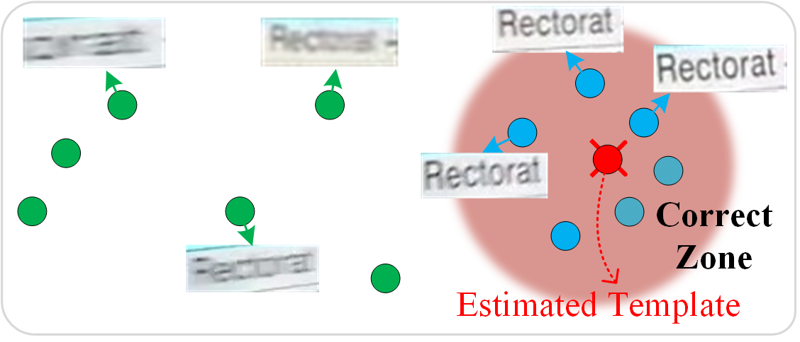
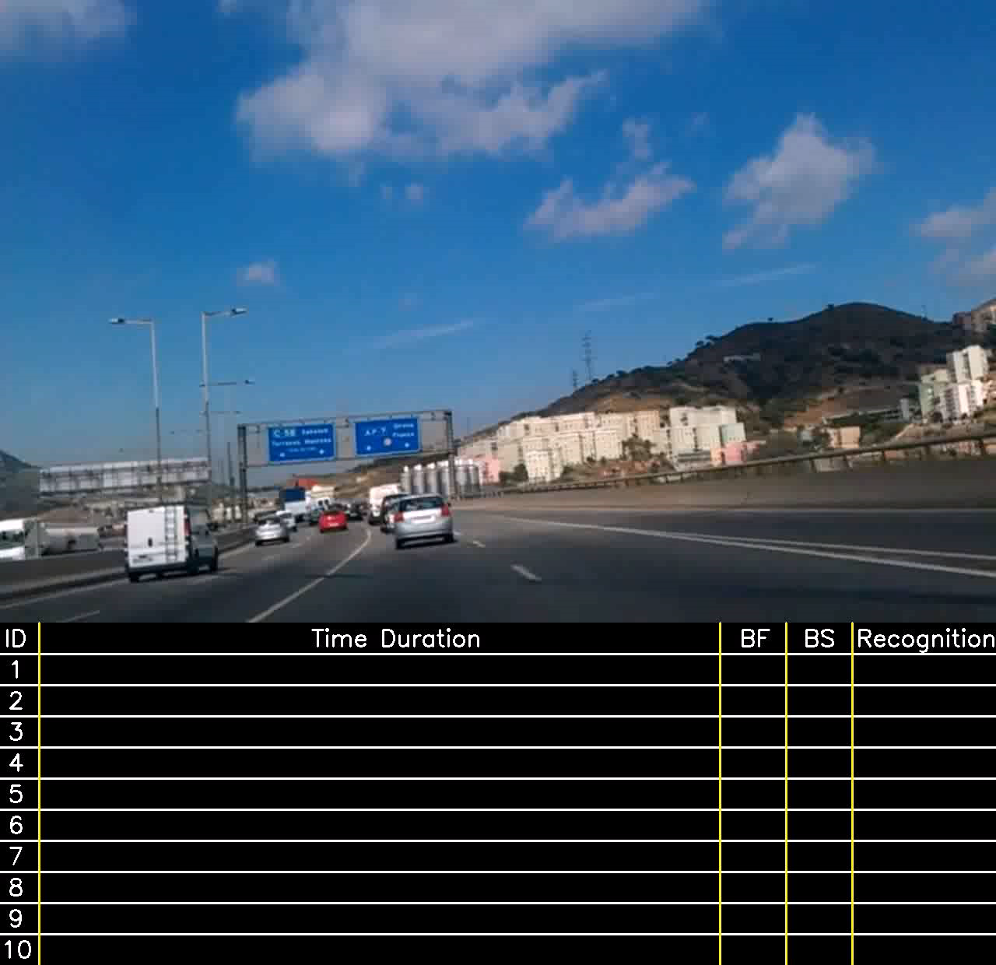
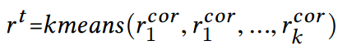
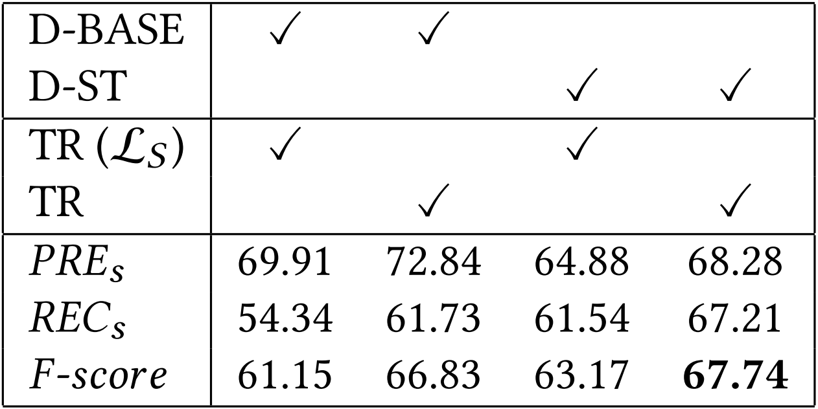
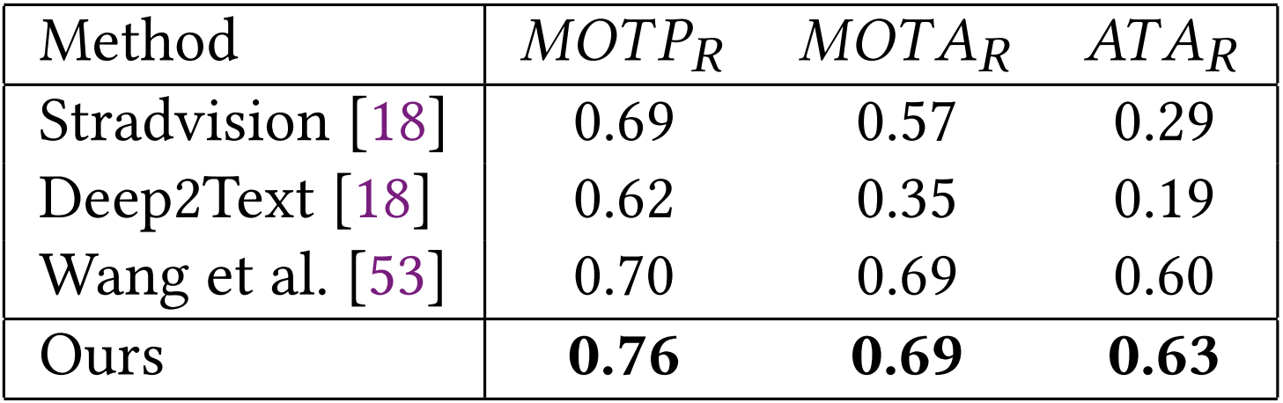
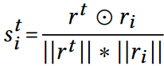
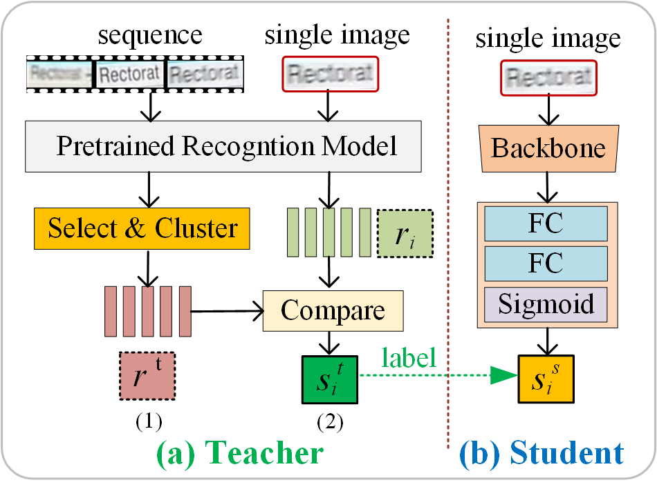
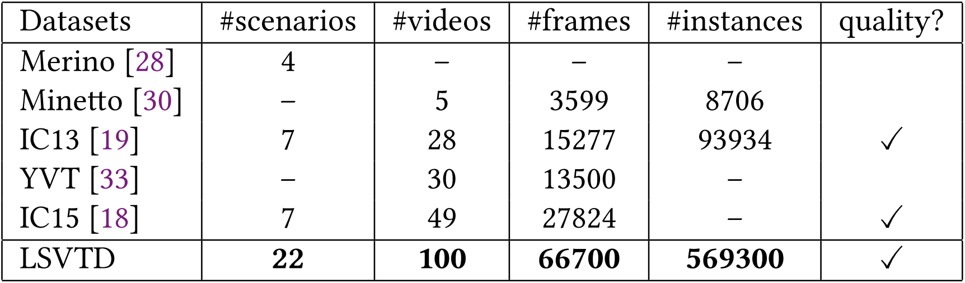
YORO-Fast Video Text Spotting
Key component
Experiments
A Demo of quality scoring and recognition
Abalation
Comparison with SoTA
Mechanism of quality scoring network
x 80 faster
(a) comparison with other frame seletion methods
(c) performance of detection on IC13
(b) effectiveness of each module on IC15
(d) performance of end-to-end on IC15
The Large Scale Video Text Dataset
Much larger scale(22 scenes)
Multilingual text
Release soon…
(1) Teacher-Student Architecture
Program ID:P2C-11
Notes:
On the right is a demo of our method.
When designing the quality scoring network, by visualizing feature space, we fould the high quality text are localised in a compact region, and the low-quality text are far from this region, so we synthesis a template with high-quality text, then we can compute the distance between text and template as the quality score. And we design a teacher-student architecture for training the network.
In our abalation, we compared with two frame selection approaches, our method is 80 (signifiacantly) times faster and achieves better recogntition performance. The detection and end-to-end performance are also better compared with state-of-art approaches.
We also collect a much larger scale dataset for video text spotting, which contains 22 indoor/outdoor scenes and multilingual text, it will be released soon.
Thank u so much for listening.

